Slide 1
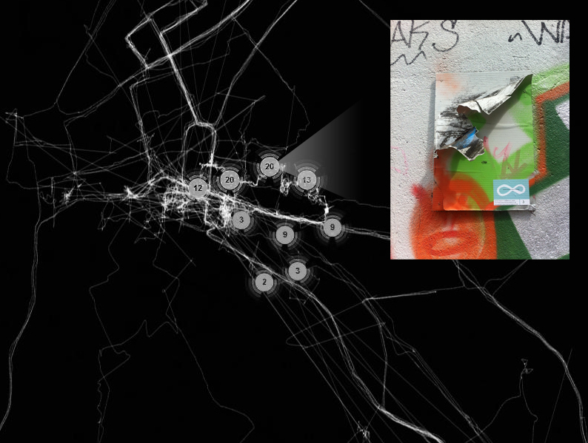
An ‘Urban Spacebook’
J . Pollock, Autumn Rhythm, 1950
Corelia Baibarac
Architect & PhD Candidate (Trinity College Dublin)
baibarac@tcd.ie

Slide 2
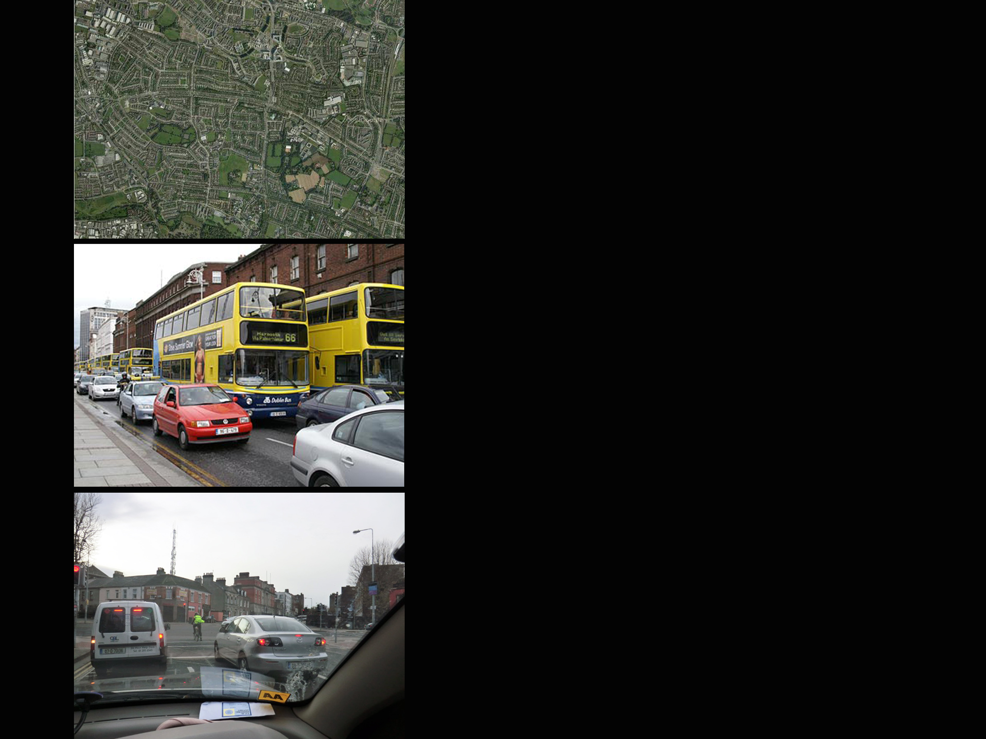
Mobility...
...a significant source of un-sustainability
spatial/infrastructural development
traffic congestion
mobility behaviours
...or a potential key towards more sustainable cities?

Slide 3

Mobility is a significant everyday life practice, which offers a useful lens for observing issues challenging the sustainability of cities.
Important issues:
ICT as means to improve the efficiency of cities
inhabitants as passive consumers rather than active citizens

Slide 4
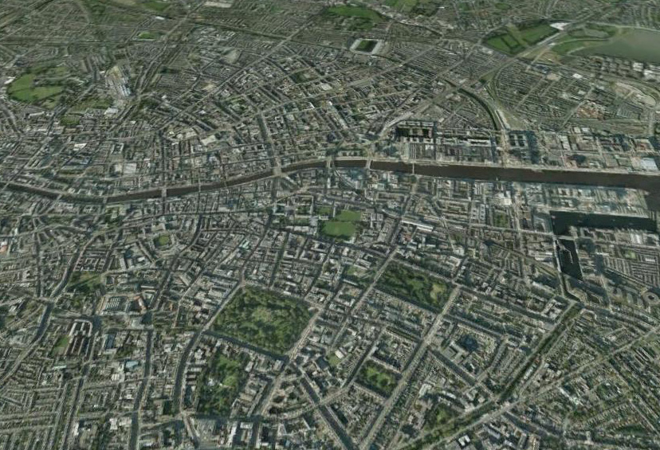
The city is more than just efficient services – it is also made of spatial and emotional experiences of the urban environment.
City decision-makers also need to consider:
data not passively generated by technological devices
data that cannot be counted and mathematically analysed
...data concerning inhabitants’ experiences of the city

Slide 5
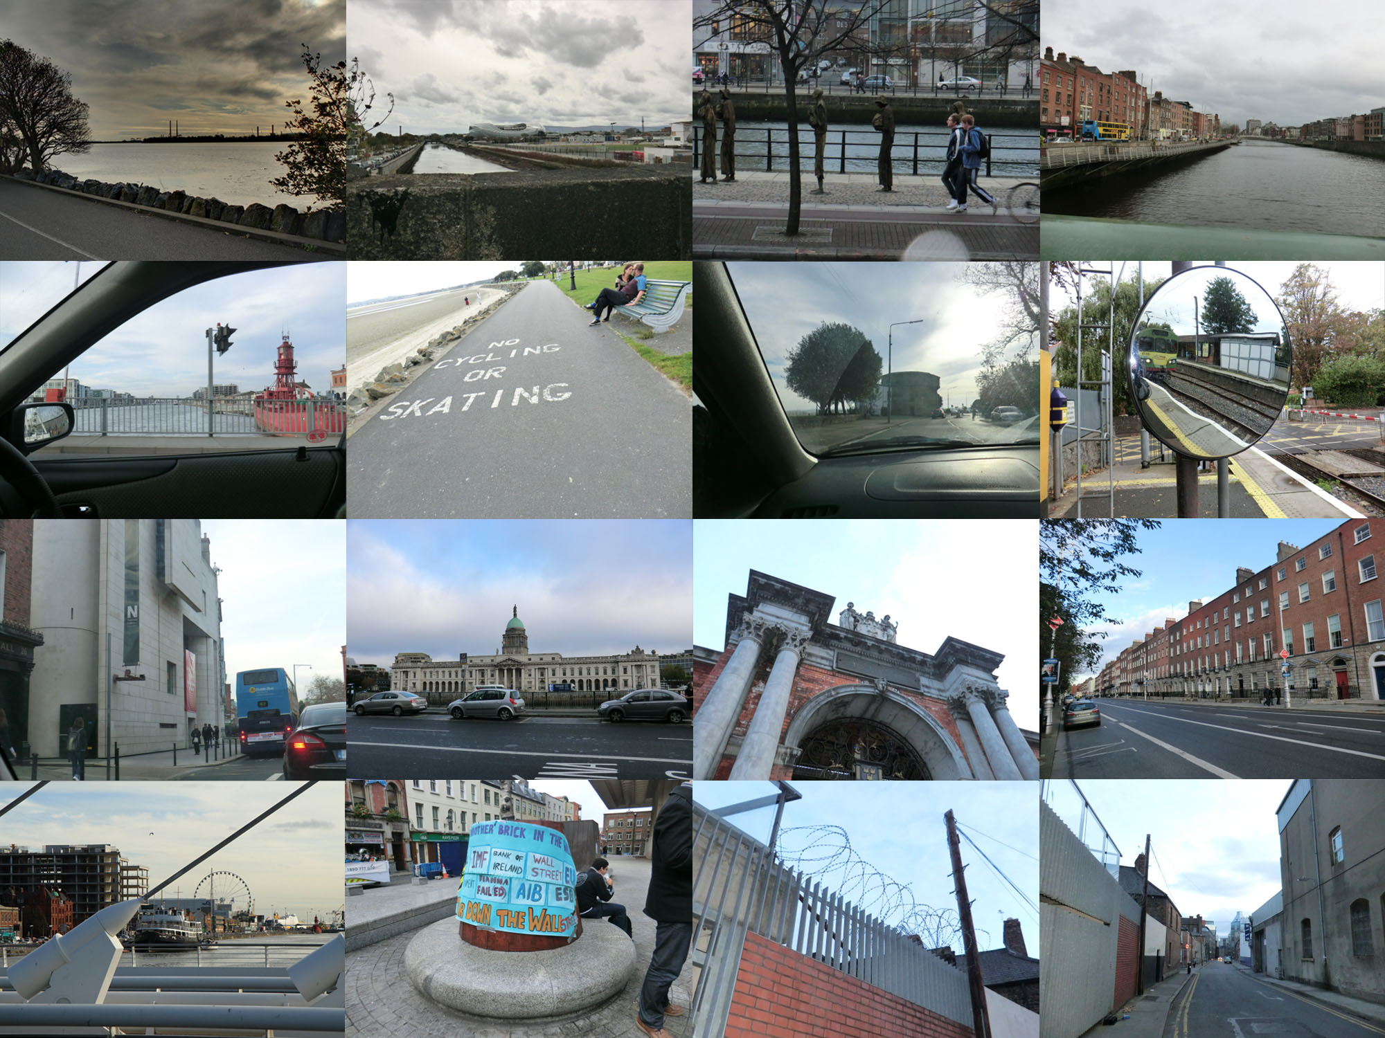
An important gap emerges in the governance of city development that challenges the city’s sustainability.
lack of data on inhabitants’ experiences
lack of appropriate mechanisms for meaningful engagement
Urban Spacebook aims to address this gap.
Dublin City
City Centre

Slide 6
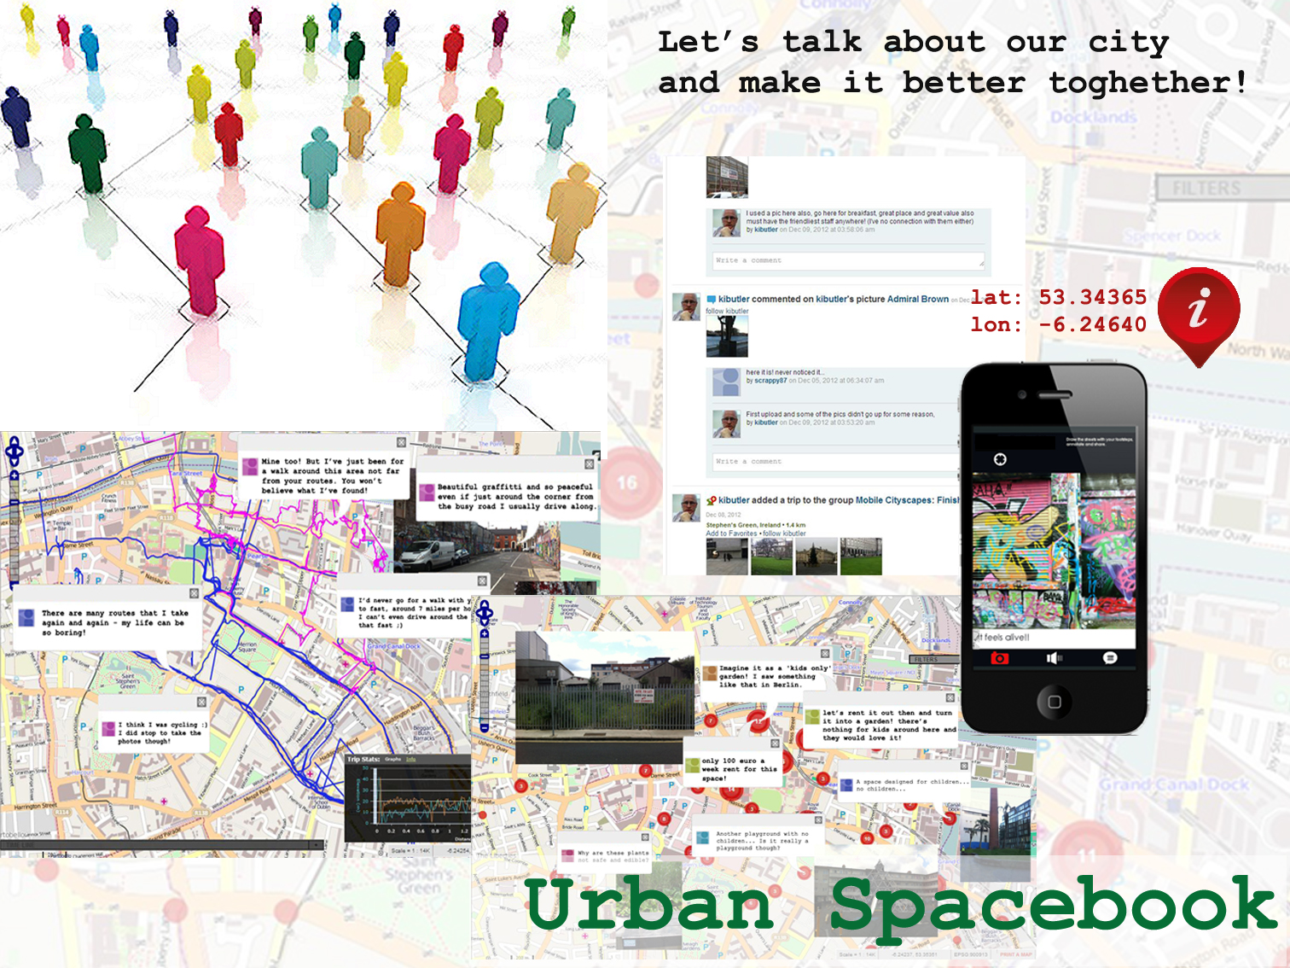

Slide 7
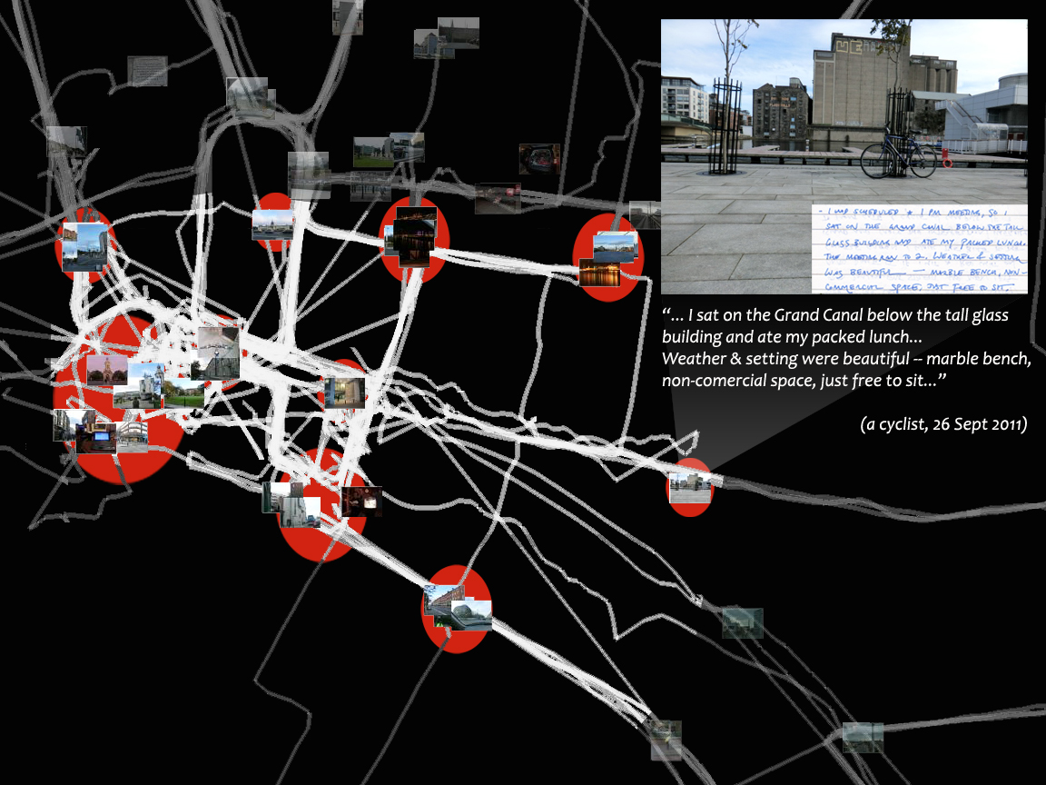
Dublin City
City Centre
TCD
Concepts based on:
hybrid diary study
technology-enabled spatial experiments

Slide 8
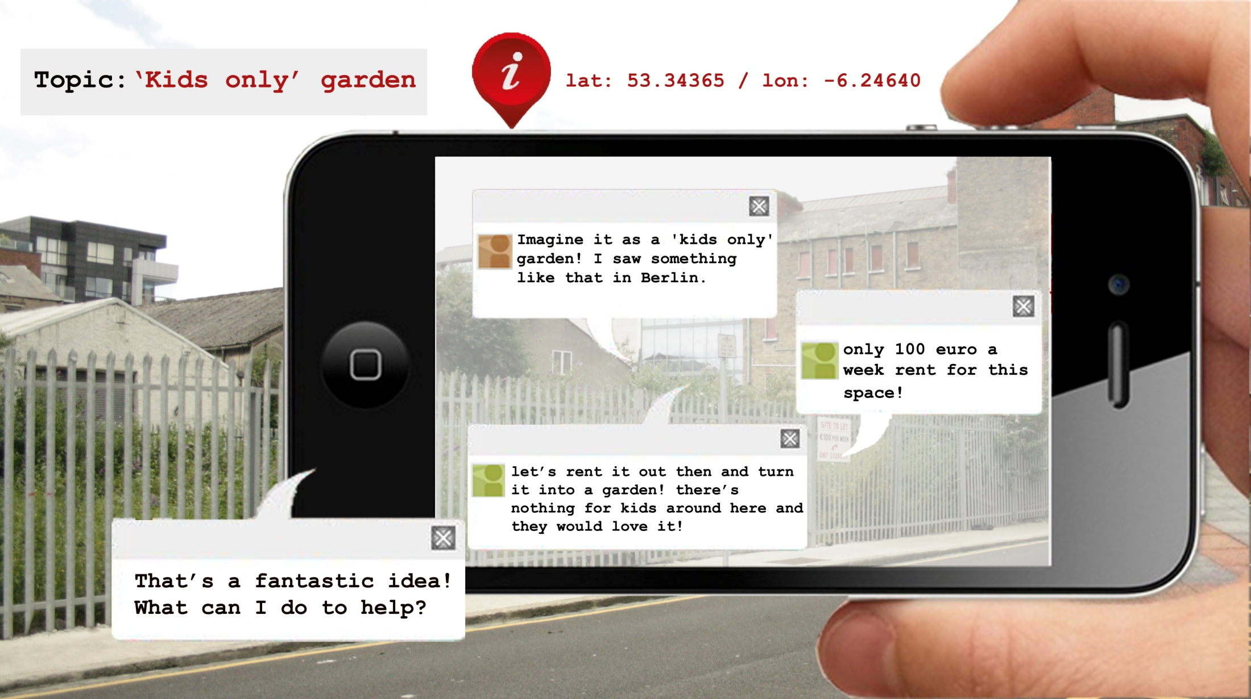
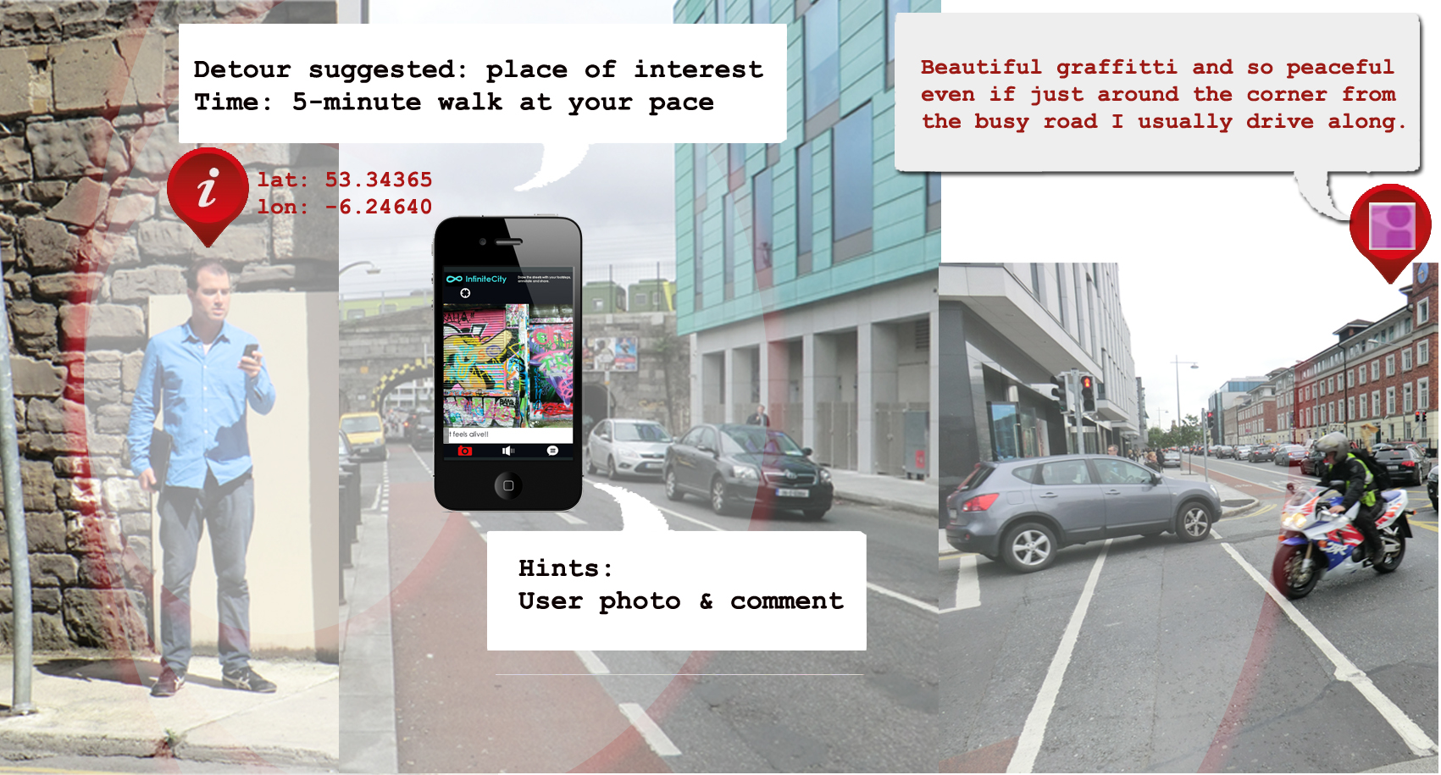
Dublin City
City Centre
TCD

Slide 9
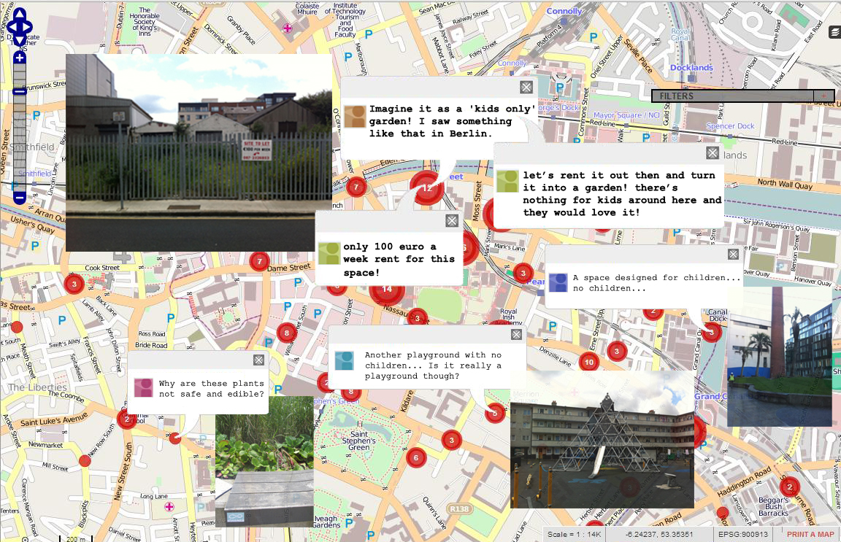
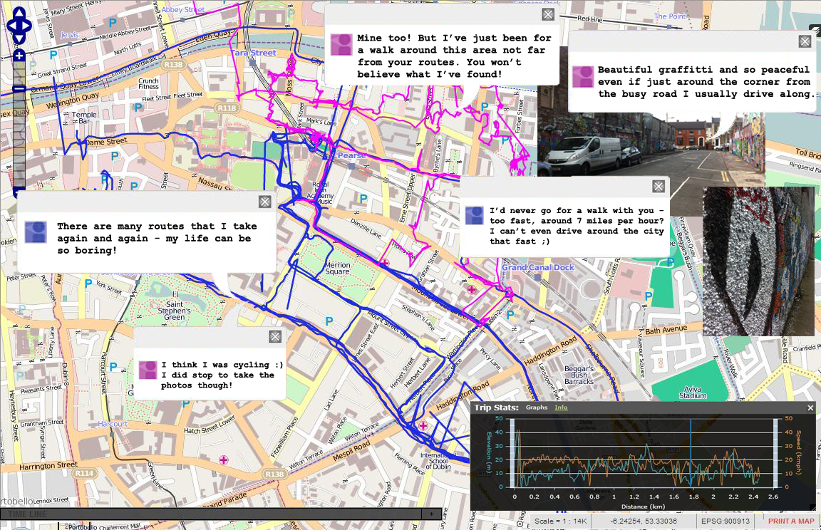

Slide 10
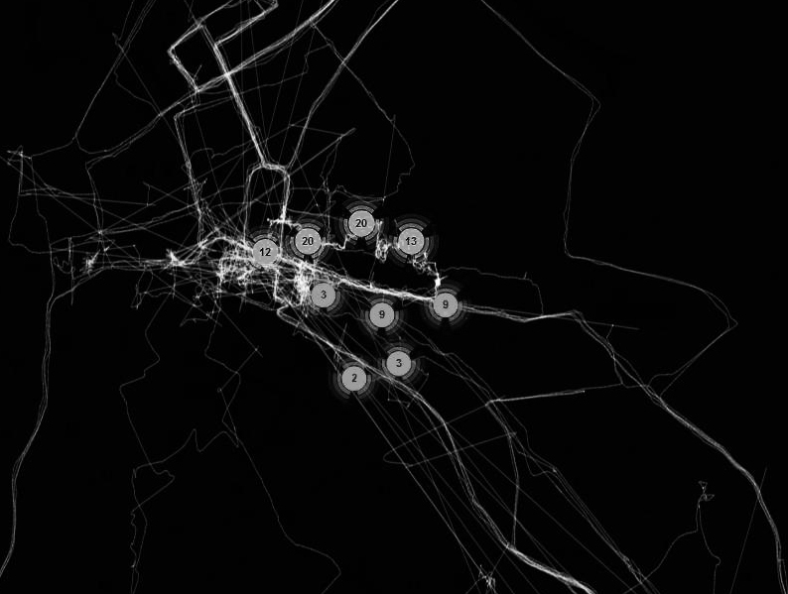
Urban Spacebook has the potential to address the gap in the governance of city development.
ongoing and proactive participation that can enhance current engagement processes
practical access to experiential, abstract data that can enhance current quantitative data

Slide 11
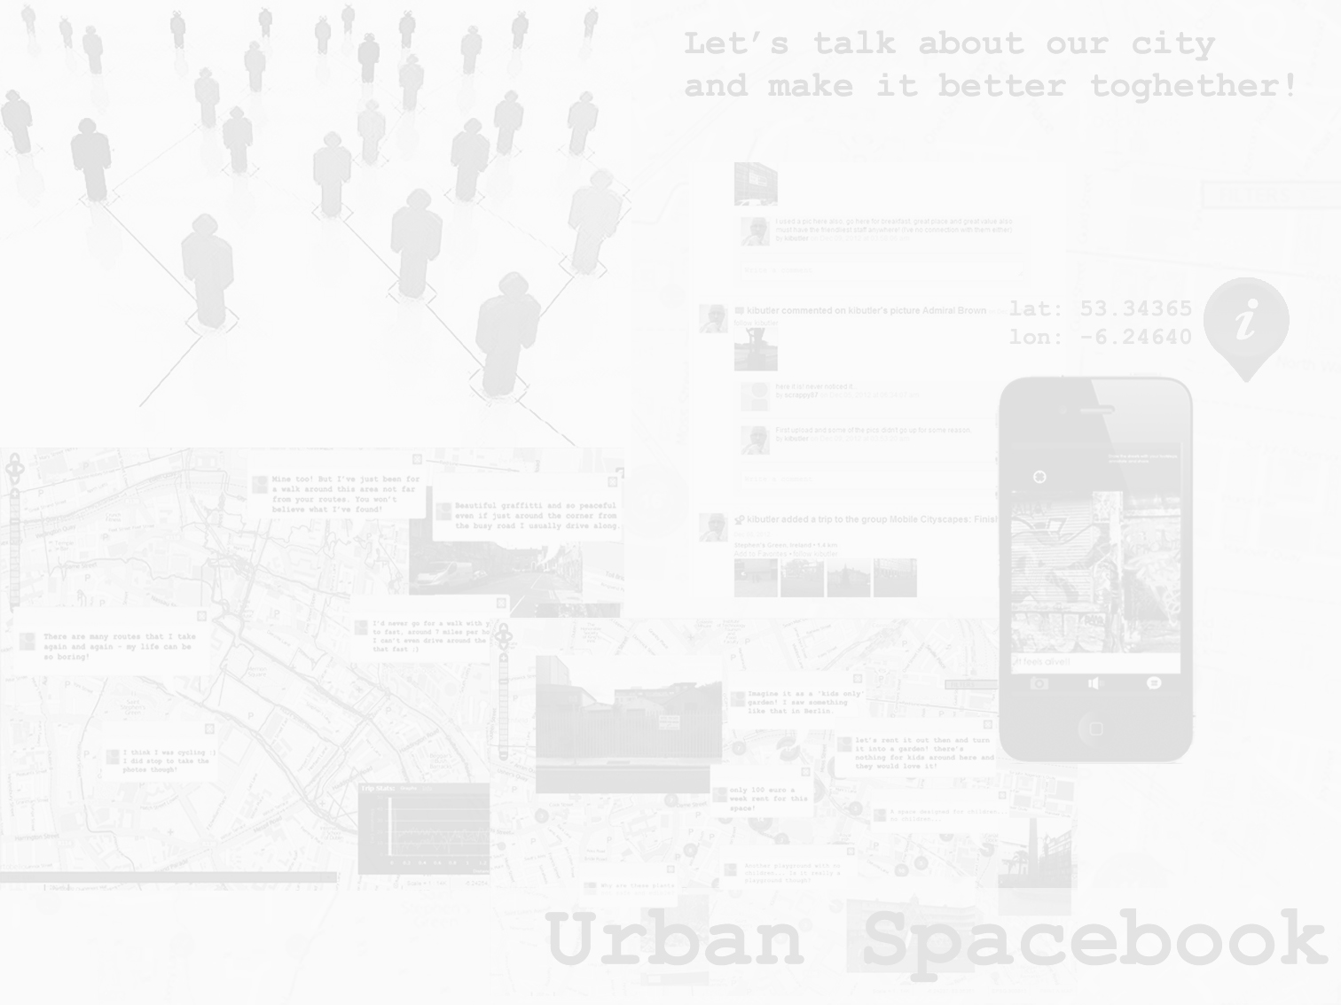
Beyond its prototype stage, the platform could foster a new form of urban governance.
engagement centred on positive, everyday aspects of the city
a space for conversations and collaboration
current and potential/future mobilities as ‘conversation starter’
qualitative aspects of GPS technology

Slide 12
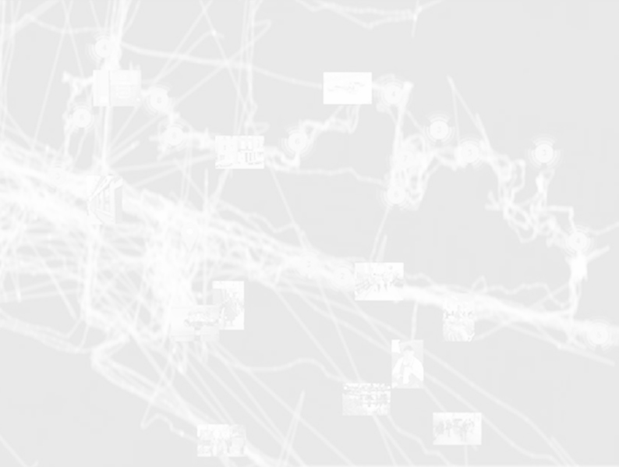
Not a silver bullet!
‘provoking’ engagement in a real situation
eliciting experiential data embedded in everyday routine
‘Big Brother’ surveillance and digital divide
mobility-based inequalities

Slide 13
We need – more urgently than architectural utopias, ingenious traffic disposal systems, or ecological programmes – to comprehend the nature of citizenship, to make serious imaginative assessment of that special relationship between the self and the city; its unique plasticity, its privacy and freedom.
Jonathan Raban, Soft City

